Slide 1
Hurtownie Danych
SSIS Zawansowany cz.1

Slide 2
Parameters & Variables

Slide 3
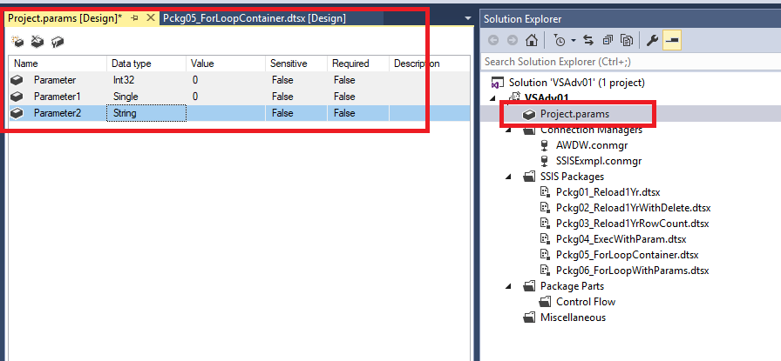
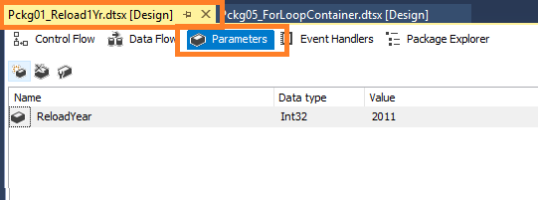
Package and Project Parameters
Integration Services (SSIS) parameters allow you to assign values to properties within packages at the time of package execution.
You can create project parameters at the project level and package parameters at the package level.
Project parameters are used to supply any external input the project receives to one or more packages in the project. Package parameters allow you to modify package execution without having to edit and redeploy the package.
https://docs.microsoft.com/en-us/sql/integration-services/integration-services-ssis-package-and-project-parameters

Slide 4
Variables
Variables store values that a SQL Server Integration Services package and its containers, tasks, and event handlers can use at run time. The scripts in the Script task and the Script component can also use variables. The precedence constraints that sequence tasks and containers into a workflow can use variables when their constraint definitions include expressions.
You can use variables in Integration Services packages for the following purposes:
Updating properties of package elements at run time.
Including an in-memory lookup table.
Loading variables with data values and then using them to specify a search condition in a WHERE clause.
Loading a variable with an integer and then using the value to control looping within a package control flow.
Populating parameter values for Transact-SQL statements at run time.
Building expressions that include variable values.
https://docs.microsoft.com/en-us/sql/integration-services/integration-services-ssis-variables

Slide 5
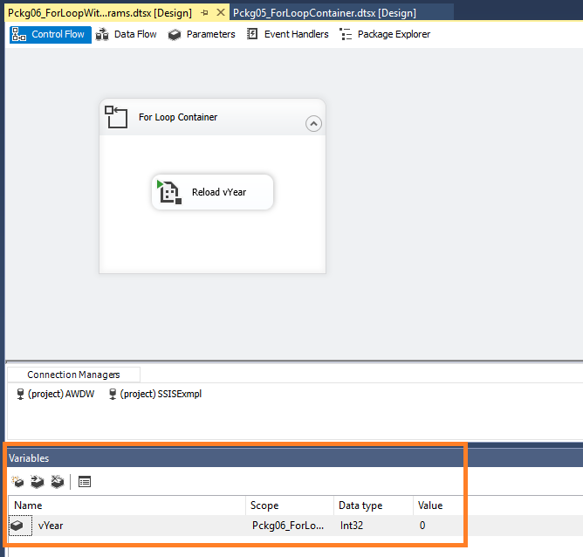
Variables

Slide 6
Precedence Constraints

Slide 7
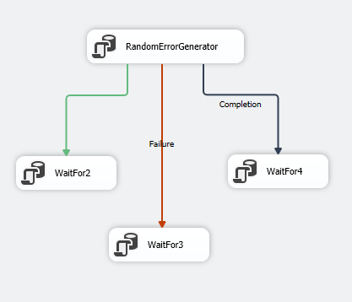
Precedence Constraint Configuration
You can configure precedence constraints in the following ways:
Specify an evaluation operation. The precedence constraint uses a constraint value, an expression, both, or either to determine whether the constrained executable runs.
If the precedence constraint uses an execution result, you can specify the execution result to be success, failure, or completion.
If the precedence constraint uses an evaluation result, you can provide an expression that evaluates to a Boolean.
Specify whether the precedence constraint is evaluated singly or together with other constraints that apply to the constrained executable.

Slide 8
Control Flow - Loops

Slide 9
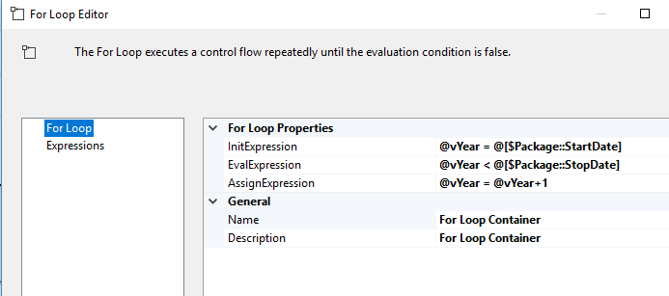
For Loop
The For Loop container defines a repeating control flow in a package. The loop implementation is similar to the For looping structure in programming languages. In each repeat of the loop, the For Loop container evaluates an expression and repeats its workflow until the expression evaluates to False.
The For Loop container uses the following elements to define the loop:
An optional initialization expression that assigns values to the loop counters.
An evaluation expression that contains the expression used to test whether the loop should stop or continue.
An optional iteration expression that increments or decrements the loop counter.
https://docs.microsoft.com/en-us/sql/integration-services/control-flow/for-loop-container

Slide 10
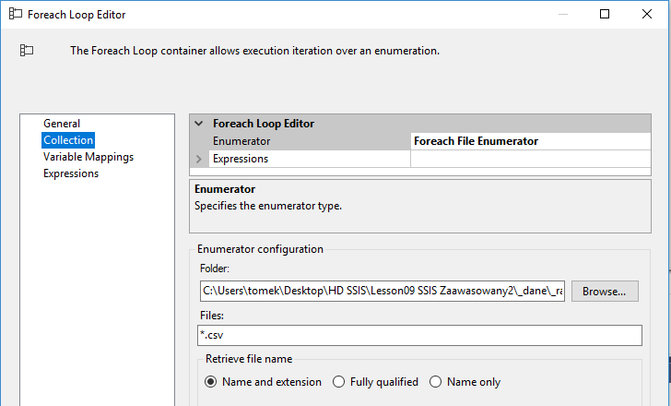
For Each Loop
The Foreach Loop container defines a repeating control flow in a package. The loop implementation is similar to Foreach looping structure in programming languages. In a package, looping is enabled by using a Foreach enumerator. The Foreach Loop container repeats the control flow for each member of a specified enumerator. Enumerator type examples:
Foreach File enumerator to enumerate files in a folder. The enumerator can traverse subfolders. For example, you can read all the files that have the *.log file name extension in the Windows folder and its subfolders.
Foreach From Variable enumerator to enumerate the enumerable object that a specified variable contains.
https://docs.microsoft.com/en-us/sql/integration-services/control-flow/foreach-loop-container

